Slide 1
Using wearable technology and machine learning to garner insight into POTS
Julie Fisher and Brandon Harden
Advisor Dr. Todd Gary
Lipscomb University College of Computing and Technology
July 2017

Slide 2
Executive Summary
Postural orthostatic tachycardia syndrome (POTS) is a poorly understood medical condition wherein 25% of patients are disabled from working.
There are few tools or quantitative measures whereby to gauge the severity of POTS, monitor symptoms, or track physiological response.
This project is to use a single patient study to determine the viability of using current wearable technology and machine learning to garner better insight into POTS.

Slide 3
Research Question
Observational study of data obtained via fitness tracker to determine associations and patterns of POTS symptoms
Can commercially available devices provide detailed enough data to detect POTS symptoms?
Can statistical analysis and machine learning be used to identify factors that will predict symptoms of POTS

Slide 4
Background
Symptoms started June 2010
Official correct diagnosis October 2013
Challenges of POTS
Underlying physiology not well understood
Sparsity of research surrounding symptoms and symptom management
Lack of tools and FDA approved medication

Slide 5
Background cont.
Real time monitoring started with a cheap Wal-Mart watch several years ago
Quantifiable observations
HRs in the 90s are a precursor to more serious symptoms
Serious symptoms generally occur with HRs in the 100s
Chest pain and palpations don’t always require high HR
Areas of further interest
Extent and manner of affect of sleep on symptoms
Amount of exercise that improves symptoms in the long term
Amount of exercise that exacerbates symptoms in the short term
Affect of different types of food on symptoms
Affect of the weather on symptoms

Slide 6
Background cont.
Fitbit Charge HR obtained May 2015
Improvements over cheap real-time only monitoring
Recorded HR at a granularity of several measurements per second
Sleep monitoring that records on a minute by minute basis
Step counts to indicate activity levels
Nutrition logging capability

Slide 7
Introduction
Postural Orthostatic Tachycardia Syndrome (POTS): An excessive increase in heart rate (HR >= 30 beats/min) with up right posture in the absence of orthostatic hypotension
Non lethal
Symptoms are easy to dismiss as psychological or not serious
Frequently misdiagnosed (average time to correct diagnosis is 6 years)
Underlying physiology not well understood
Known symptom triggers
Postural changes (moving between laying down, sitting, and standing)
Poor sleep
Low blood volume
Dehydration
Potential genetic mutation
Potential angiotensin II relation

Slide 8
Dataset
Single patient observational study using the data from the Fitbit Charge HR
Heart rate
Sleep quality and quantity
Activity level tracked using a pedometer
Sporadic nutrition logging
Generalized location data
Also available are prior medical records
Insider knowledge of the condition, which may present both opportunities and challenges
NOAA historic weather data
Temperatures through out the day
Barometric pressure
Humidity
Precipitation

Slide 9
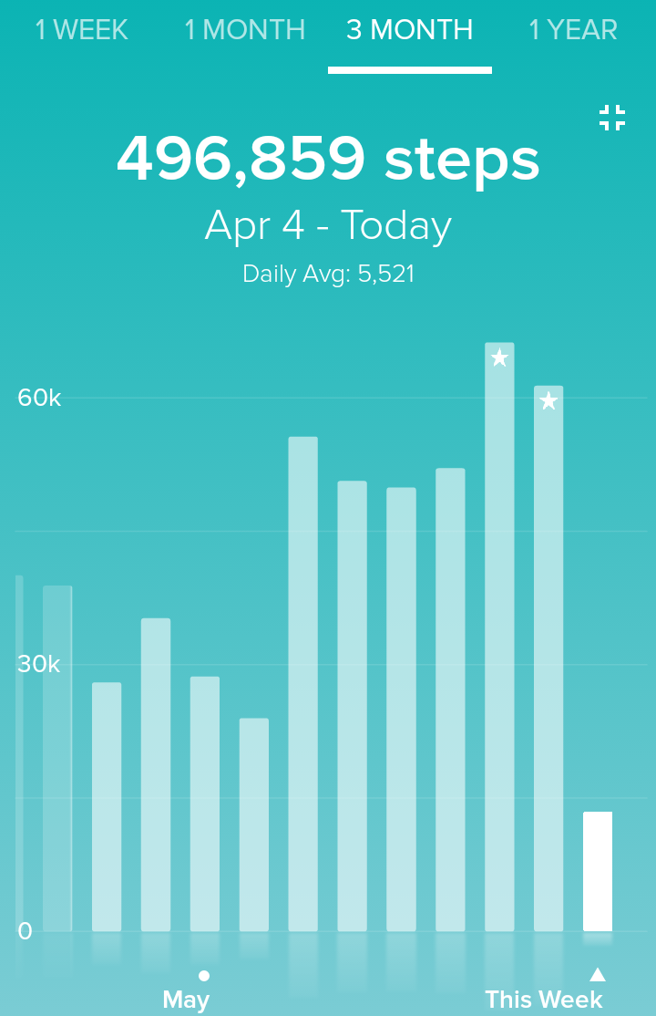
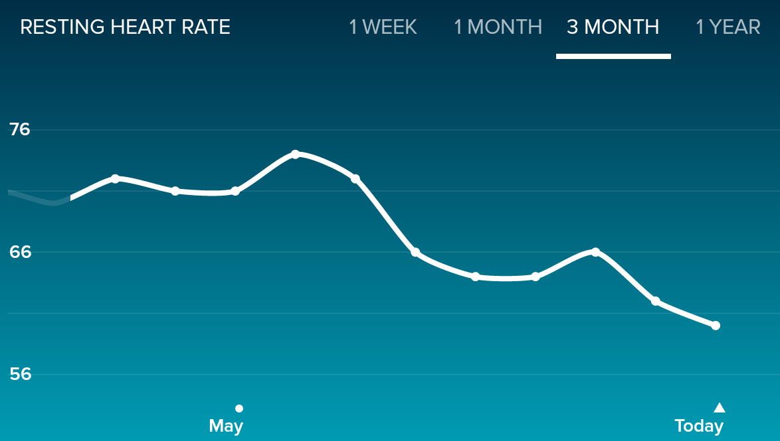
Data Science Approach

Slide 10
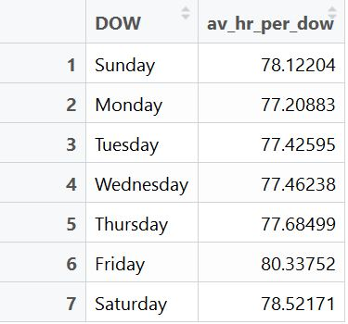
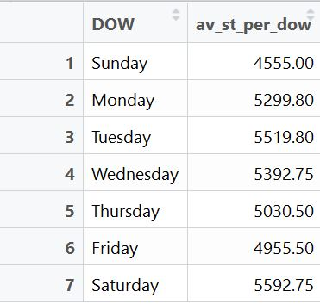
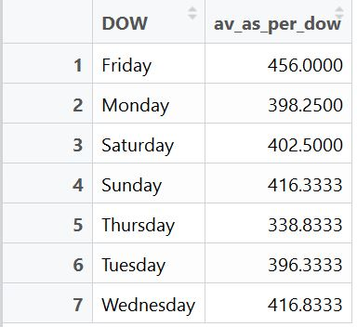
Preliminary results
Averages by day of week for heart rate in bpm, steps, and sleep in minutes

Slide 11
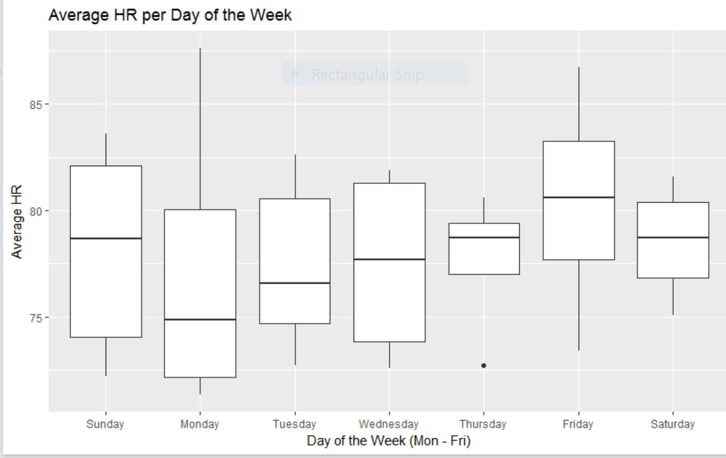
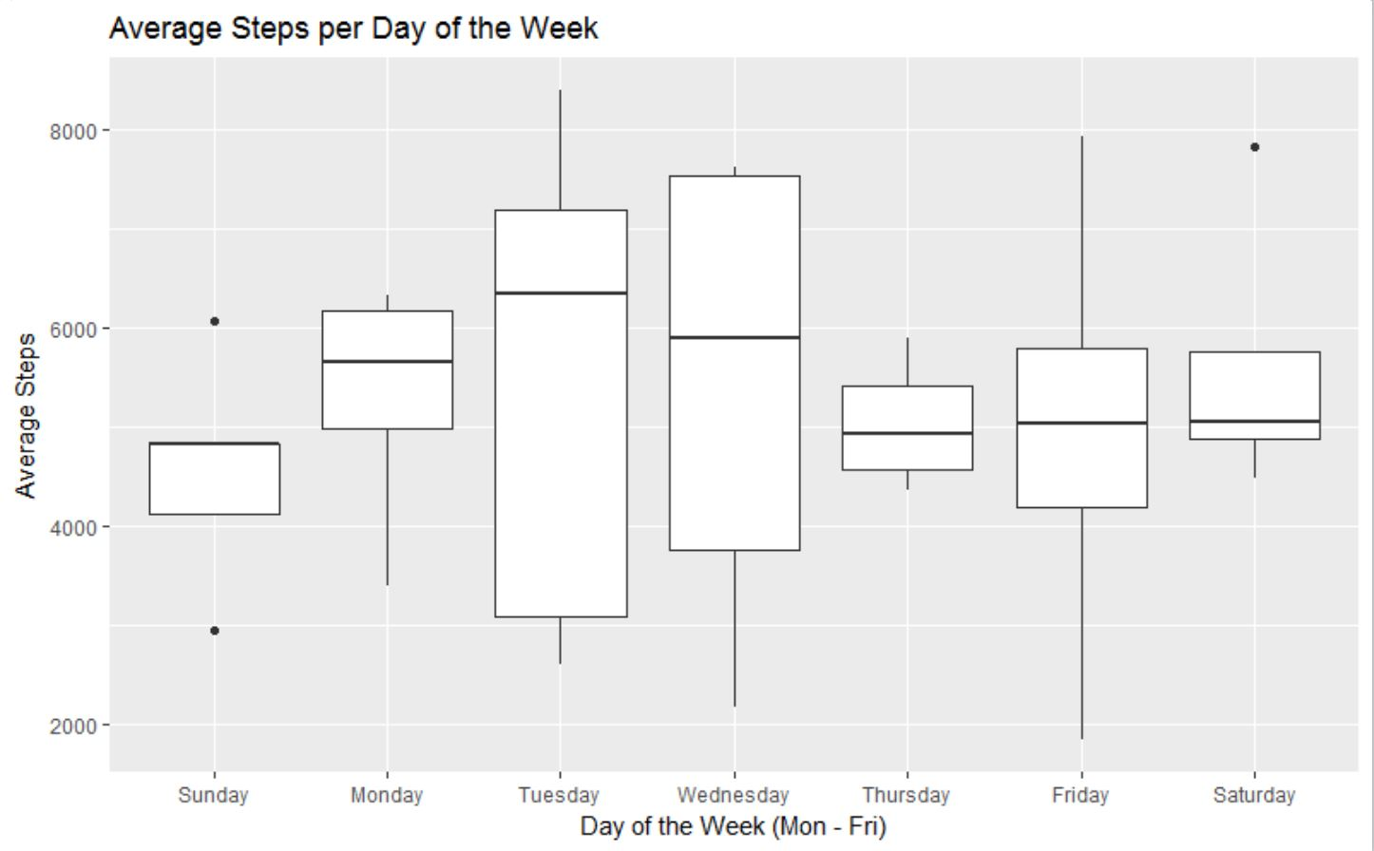
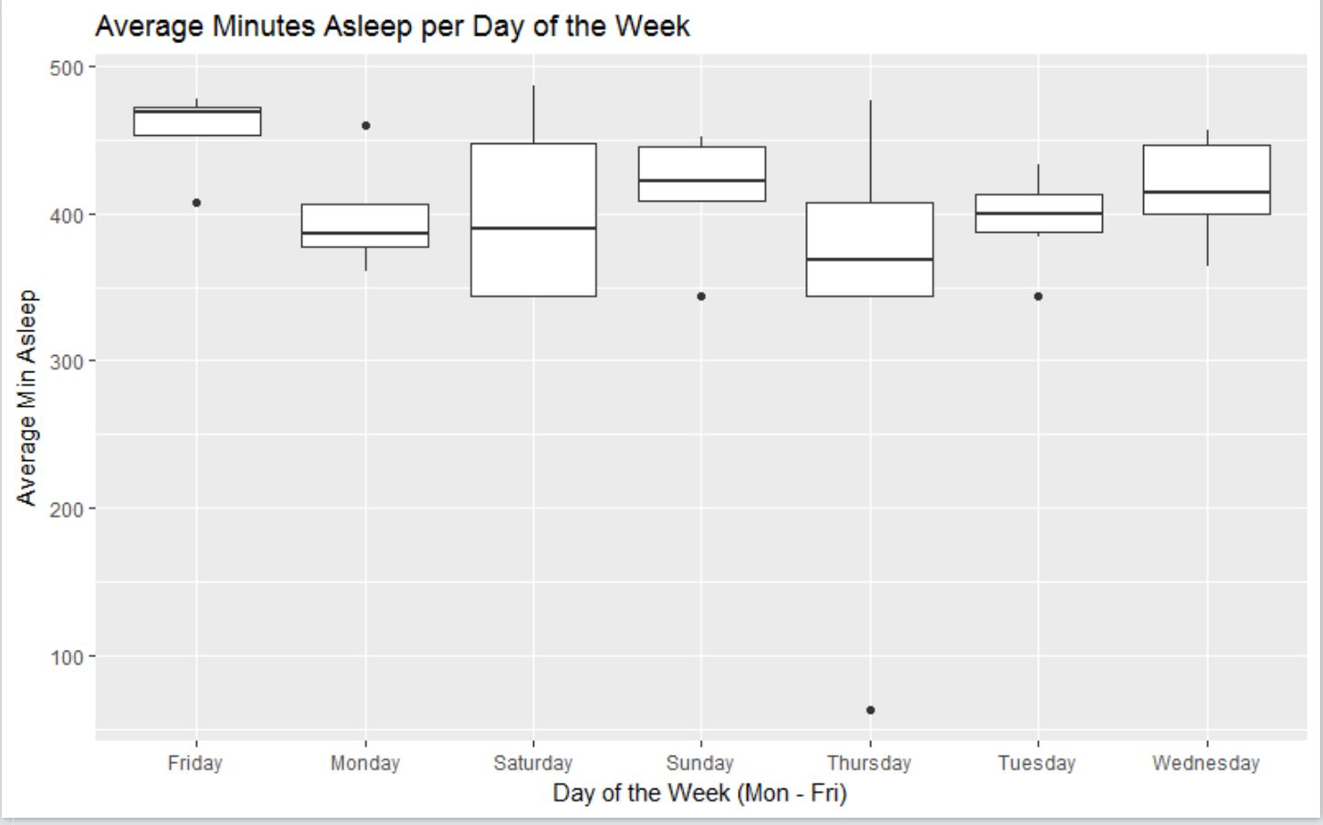
Box plots showing the averages per day of the week for heart rate by bpm, steps, and sleep by minute

Slide 12
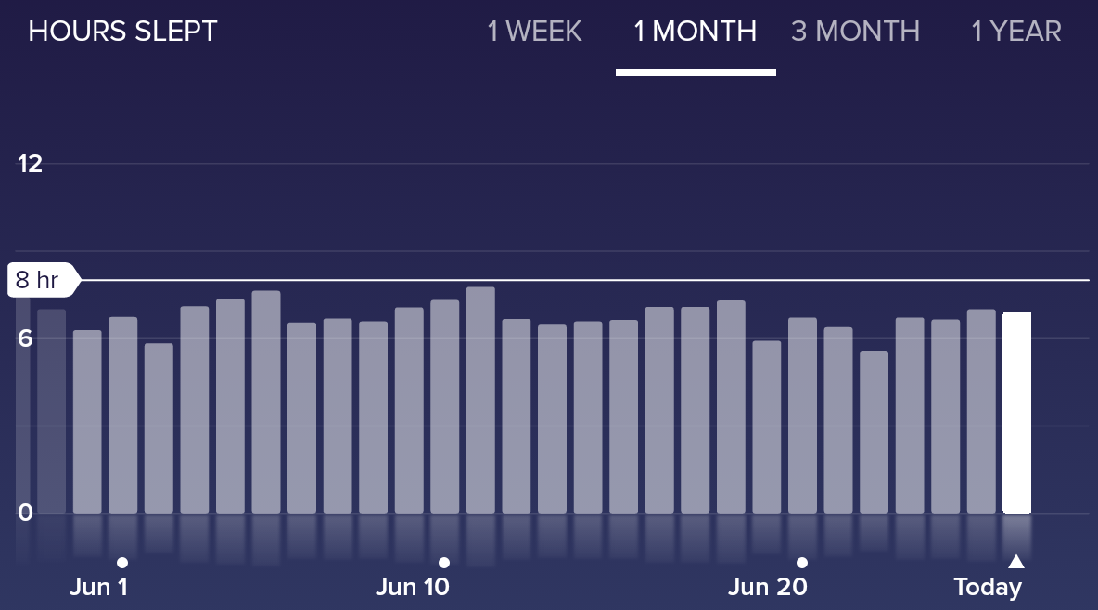

Slide 13
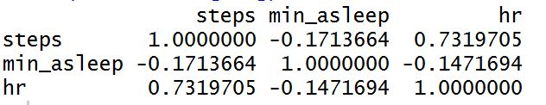
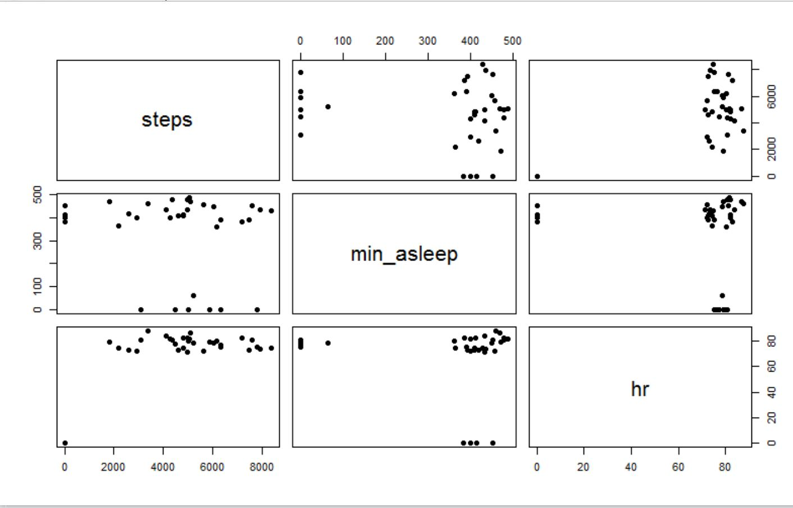
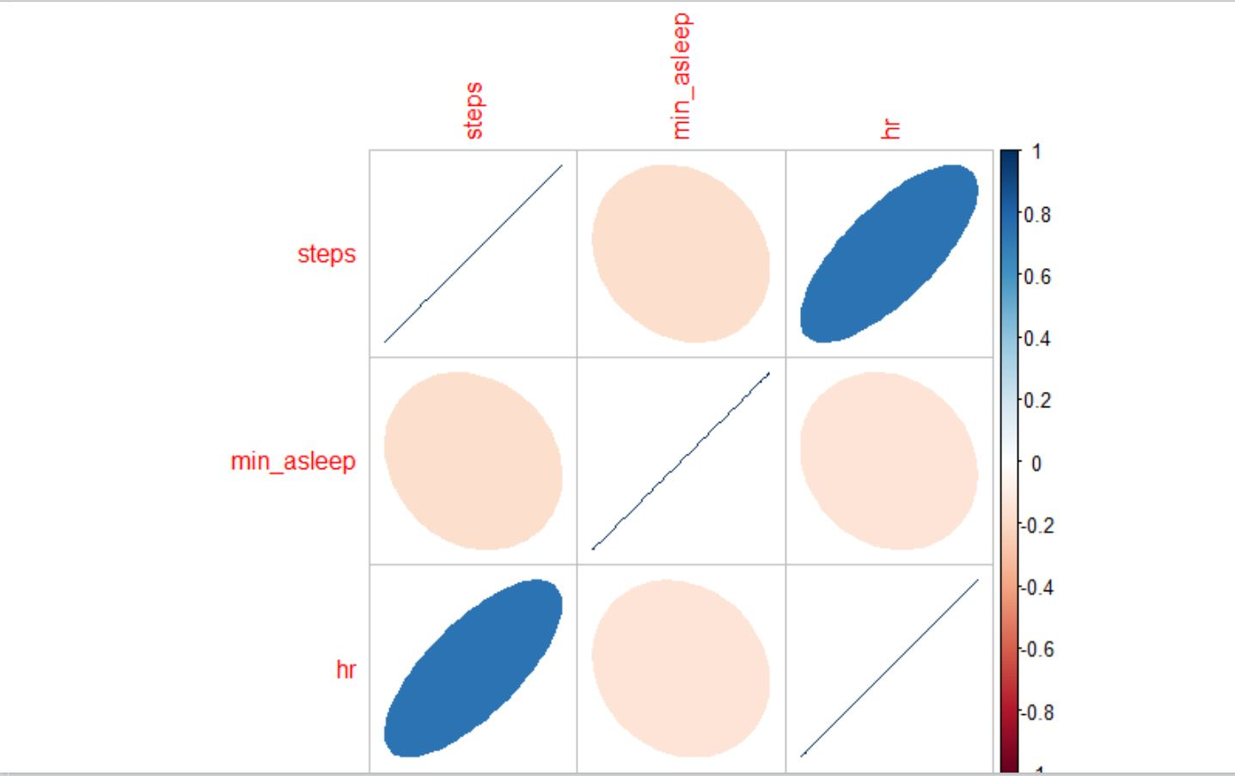

Slide 14
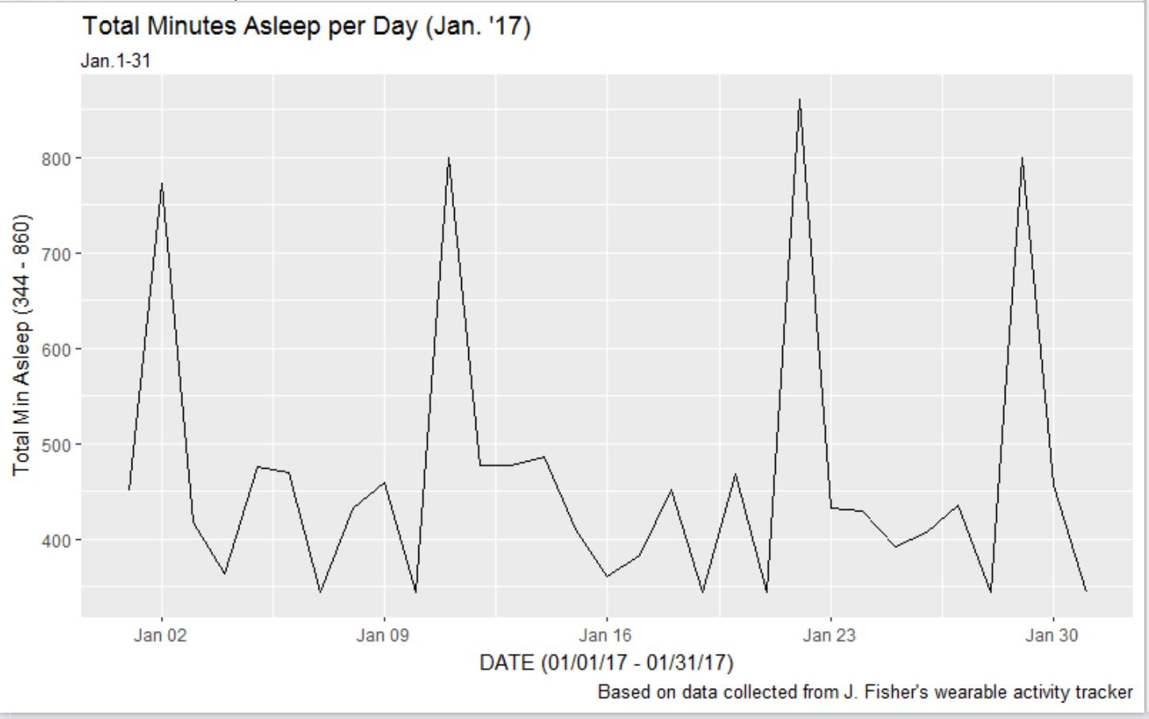
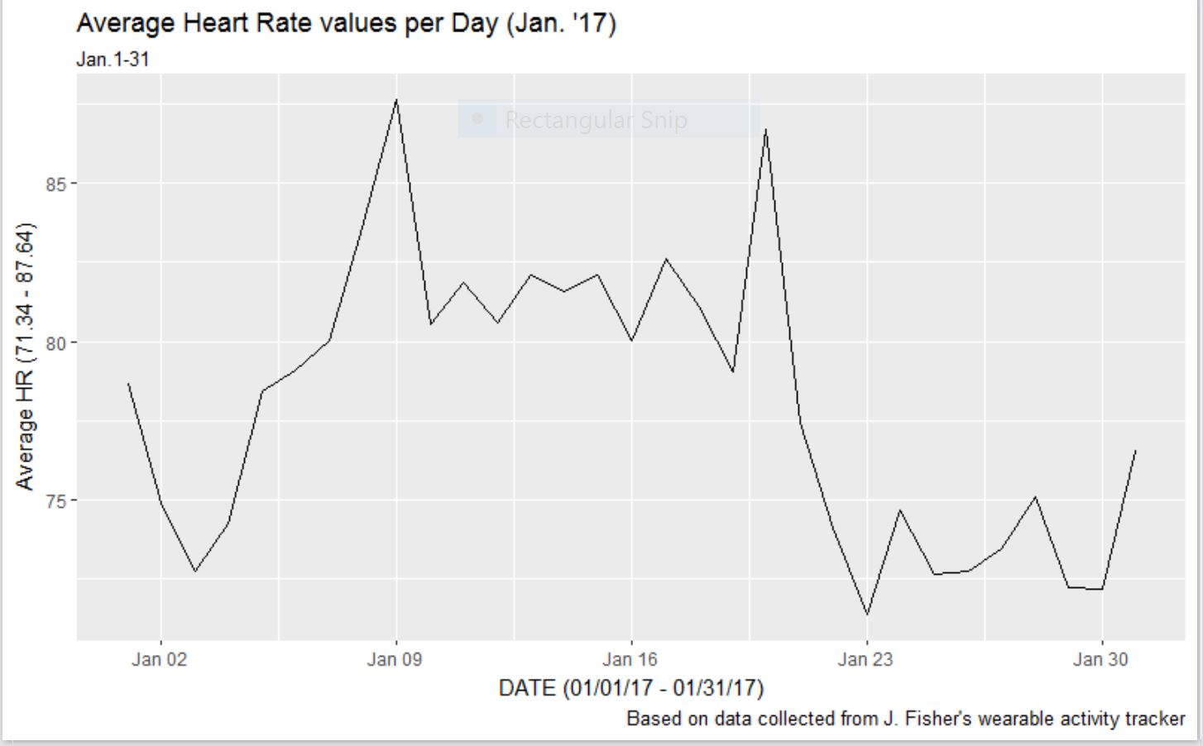

Slide 15
Importance of Work
0.2% of the population is estimated to be affected by this condition – about 500,000 people in the US alone
25% of patients are disabled to the point of being unable to work
Current treatment is limited to trial and error, and is poorly quantified – feeling better or worse without hard measurements
Current treatment has no long term studies on viability or effects – no FDA approved medication for this syndrome

Slide 16
Importance of Work cont.
Potential proof of concept
If observational and quantitative methods are proven viable using commercial wearable technology this technique could be expanded to medical experiments into medication
If associations and patterns are identified and a model can be built to predict symptoms, these identified factors can be used to guide additional research into the underlying mechanisms
Potential cost saving method in conduction observational studies and research experiments

Slide 17
Potential Challenges
Accuracy
Missing data
Acceptance of the medical community
Limited scope – single patient study
Limited medical knowledge of the involved researchers

Slide 18
Future Work
Collaborate with experts in the fields of wearable technology and POTS
Expand study to a cohort of POTS volunteers to determine whether findings are generalizable to the larger POTS population or subgroups within the population
Recruit volunteer control subjects
Identify devices that capture continuous heart rate
Address concerns of cross device and cross platform comparability
Build an app to capture data of cohort and controls if necessary
Build parser to load data into a database if necessary

Slide 19
Conclusion
Wearable technology, statistical analysis, and machine learning provide a promising frontier for better understanding POTS.
Controlling for accuracy, these tools provide viable ways whereby patients and doctors can gauge physiological responses and severity of symptoms.

